Slide 1
MUSIC STORE DATA ANALYSIS
PRESENTED BY :
S.VINAY KUMAR

Slide 2
WHAT IS SQL ? WHY IT IS USED
SQL is nothing but structured query language .
SQL is used for retrieving the data , inserting the data , delete the data from RDBMS.
Structured Query Language, is a programming language designed for managing and manipulating relational databases.
SQL provides a standardized way to interact with databases, allowing users to define the structure of their data (through schema definition) and perform various operations on the data stored in those databases.

Slide 3
WHAT IS A QUERY ?
A query in SQL is a command or request written in SQL language to retrieve, manipulate, or manage data in a relational database.
Queries are used to perform operations like selecting specific data, filtering, sorting, and aggregating information from one or more database tables.
The WHERE clause is often used to filter the rows returned based on a specified condition.
The ORDER BY clause is used to sort the result set based on one or more columns.

Slide 4
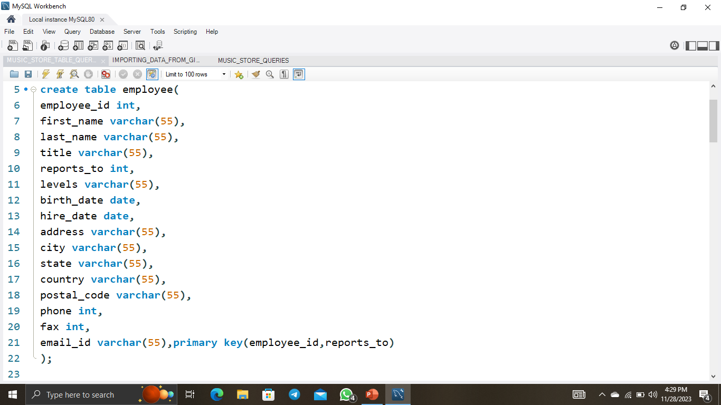
CREATING EMPLOYEE TABLE

Slide 5
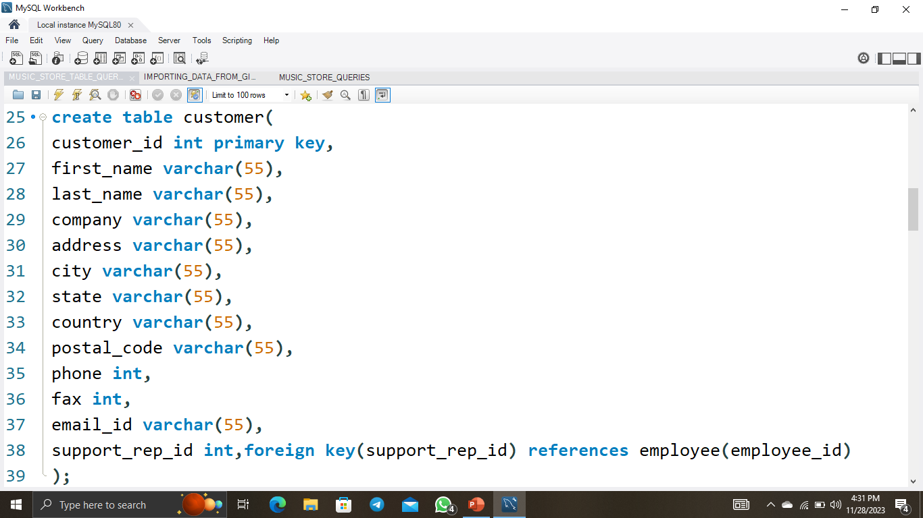
CREATING CUSTOMER TABLE

Slide 6
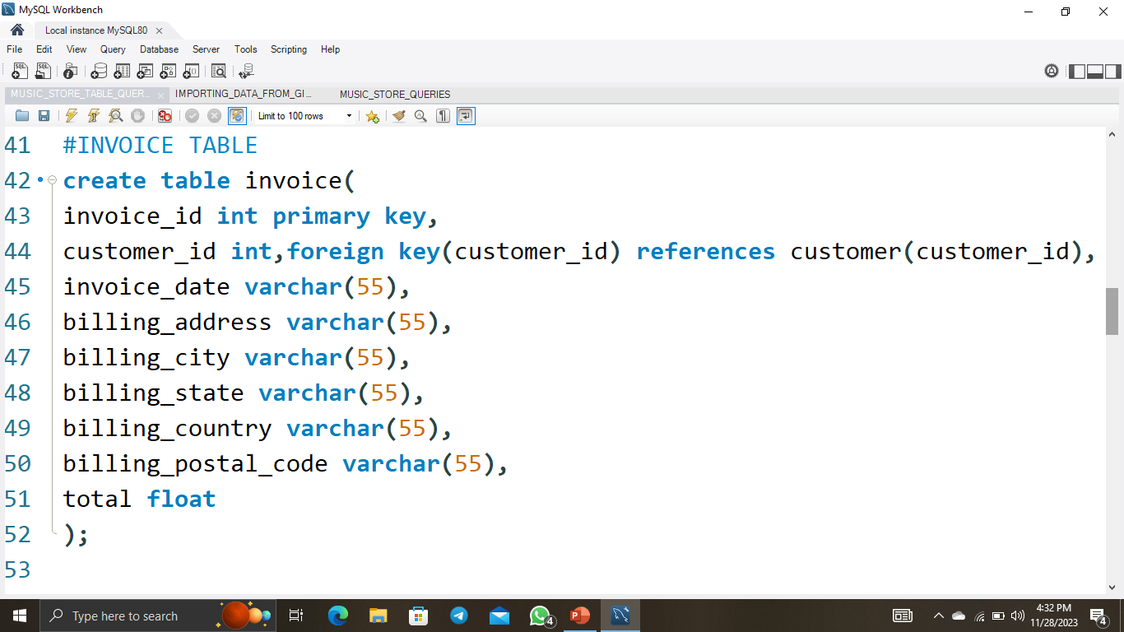
CREATING INVOICE TABLE

Slide 7
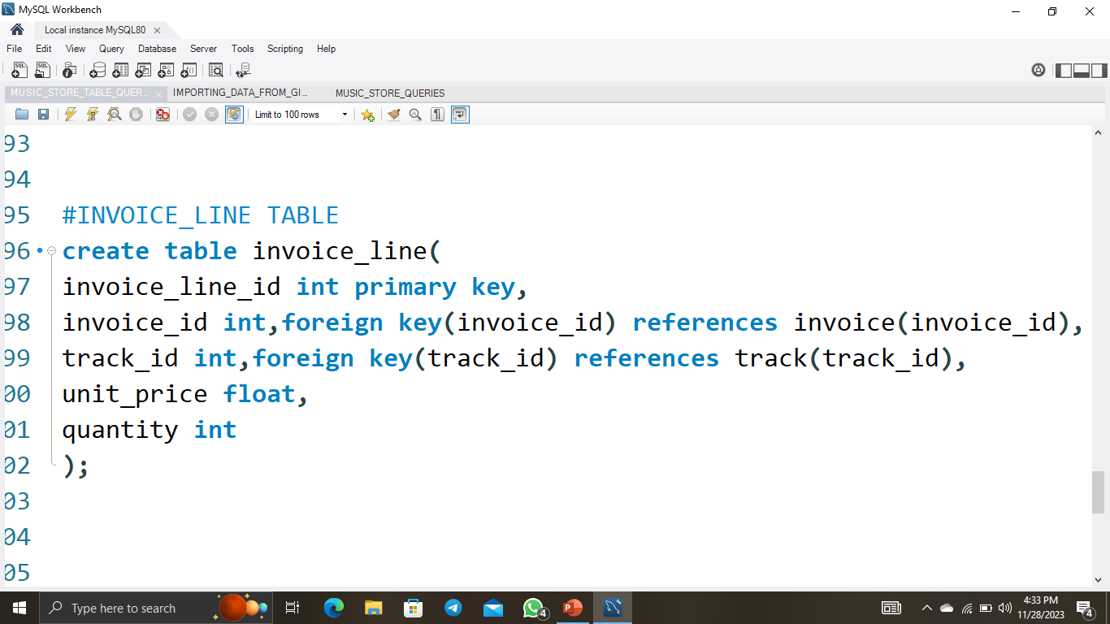
CREATING INVOICE_LINE TABLE

Slide 8
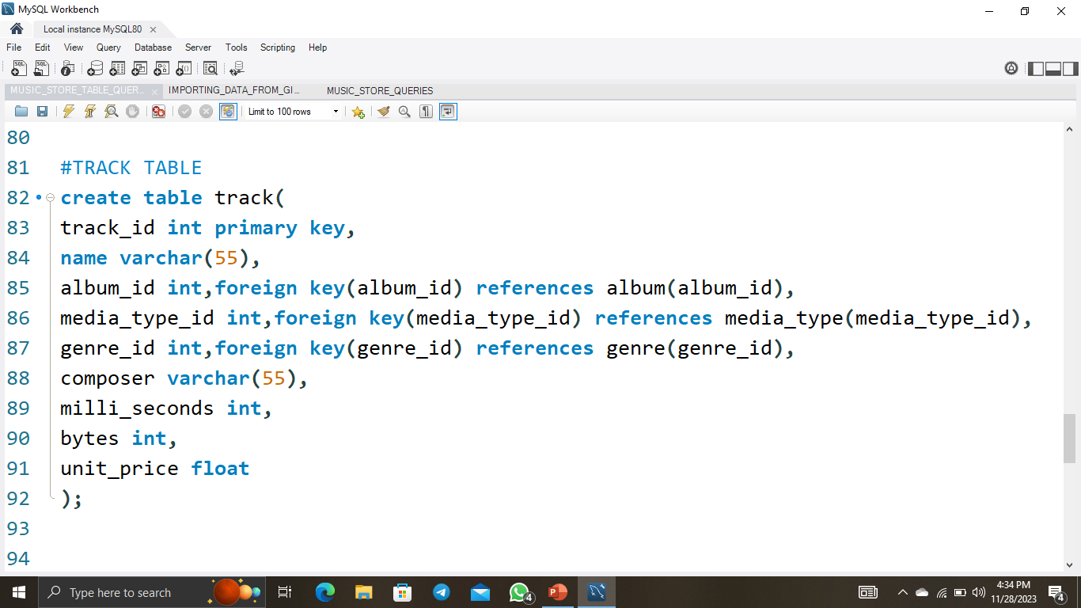
CREATING TRACK TABLE

Slide 9
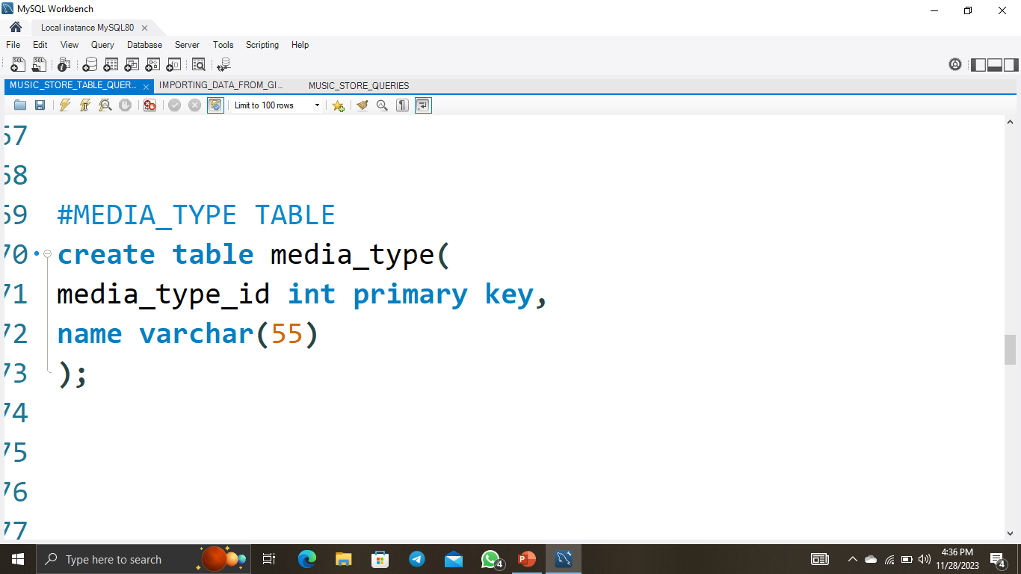
CREATING MEDIA_TYPE TABLE

Slide 10
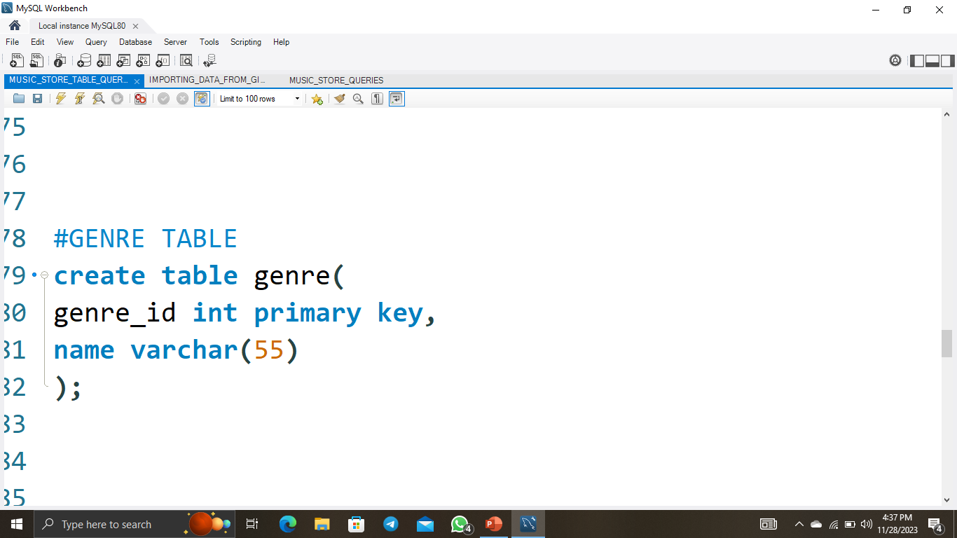
CREATING GENRE TABLE

Slide 11
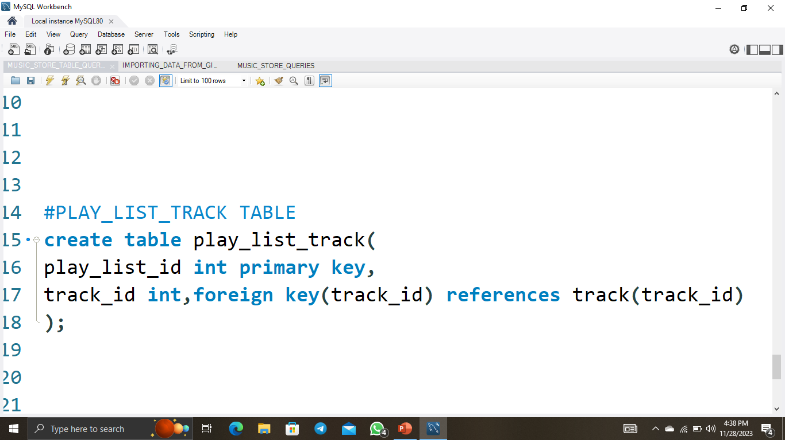
CREATING PLAYLIST_TRACK TABLE

Slide 12
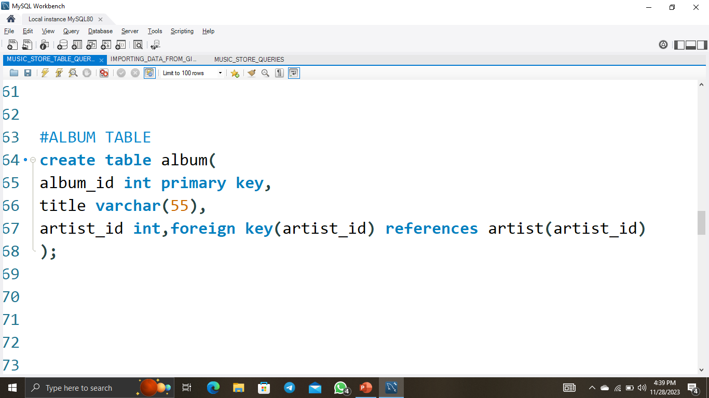
CREATING ALBUM TABLE

Slide 13
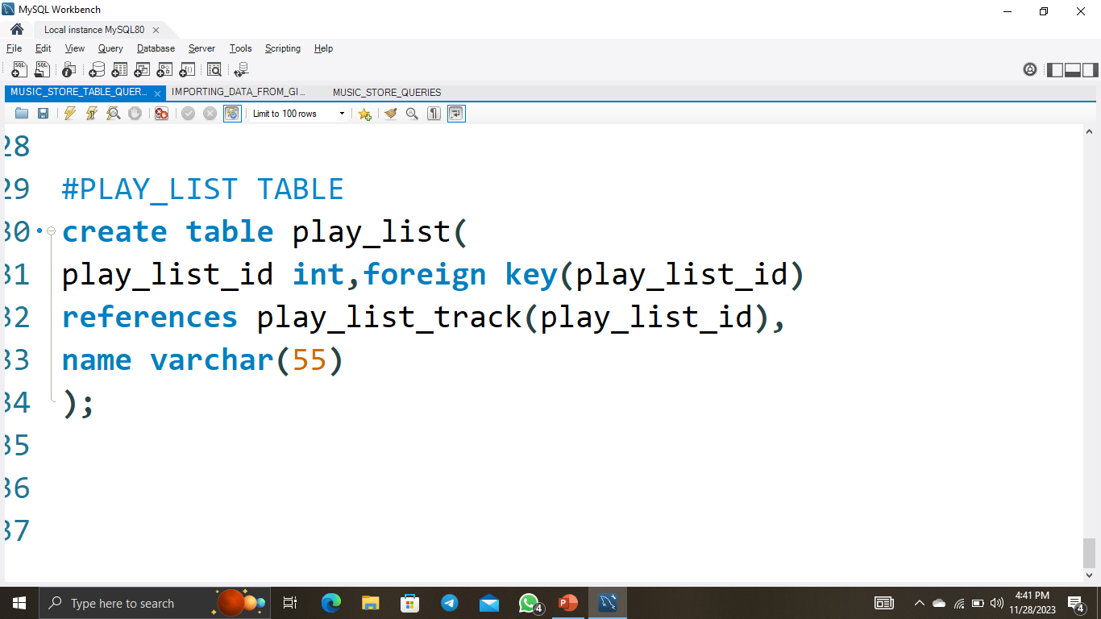
CREATING PLAYLIST TABLE

Slide 14
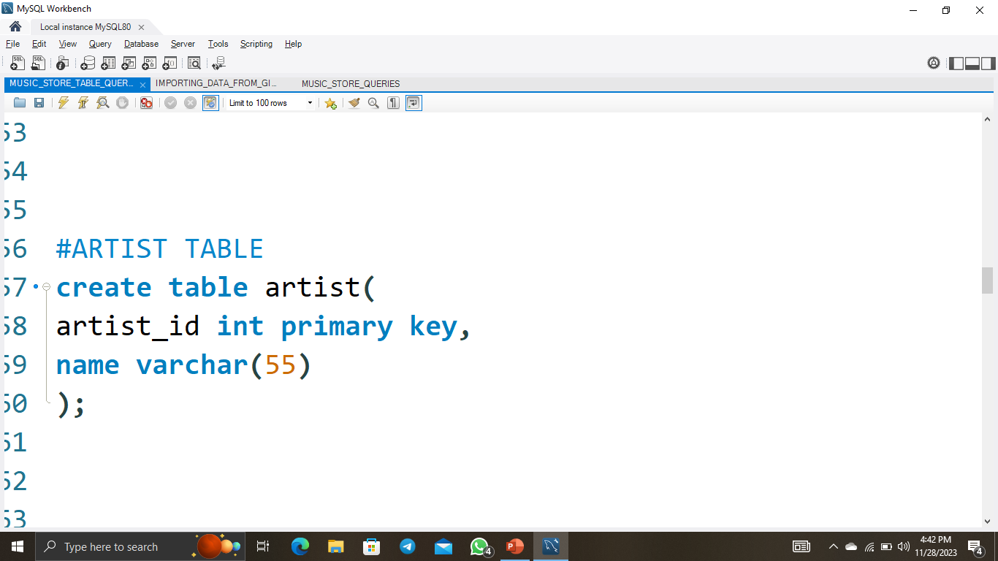
CREATING ARTIST TABLE

Slide 15
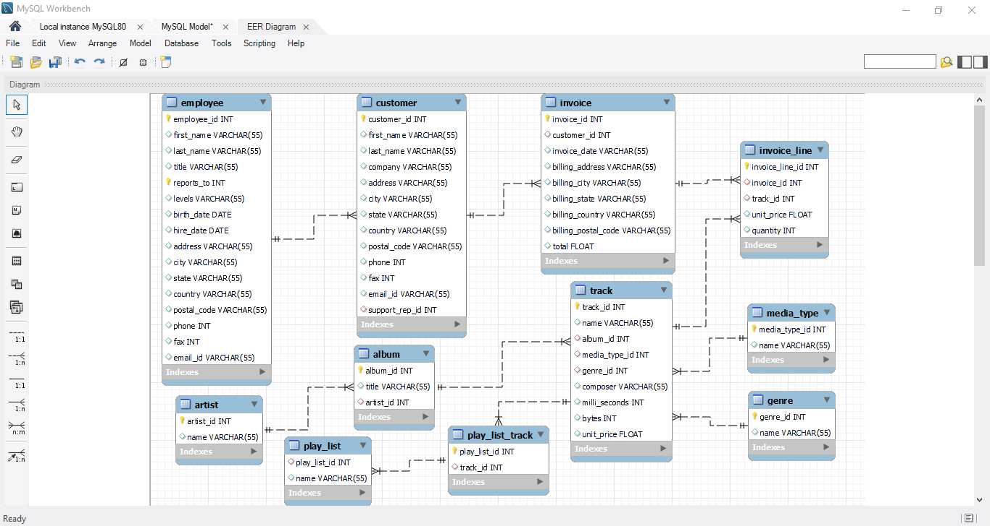
SCHEMA DIAGRAM

Slide 16
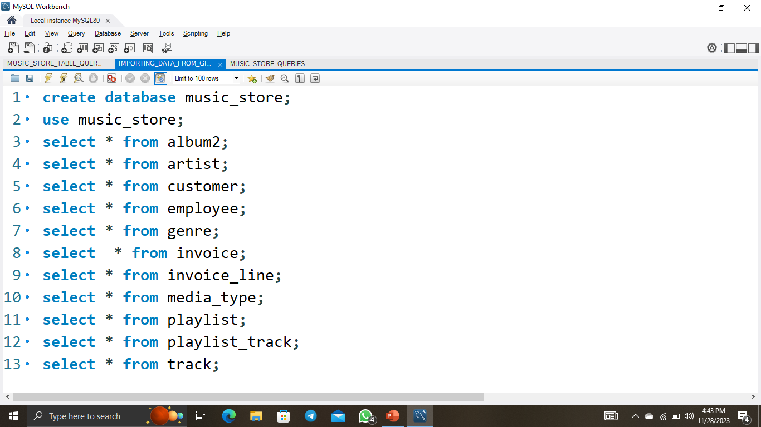
IMPORTING AND RETREIVING THE DATA

Slide 17

Q1: Who is the senior most employee based on job title?
select title , first name ,last name from employee order by title desc limit 1;

Slide 18
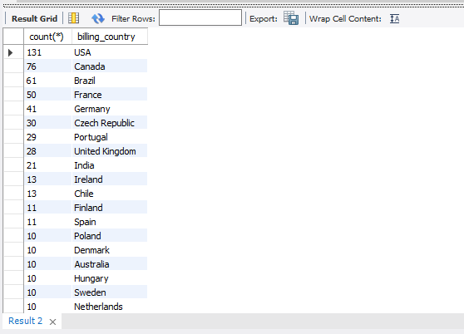
Q2: Which countries have the most Invoices?
select count(*),billing country from invoice group by billing country order by count(*) desc;

Slide 19
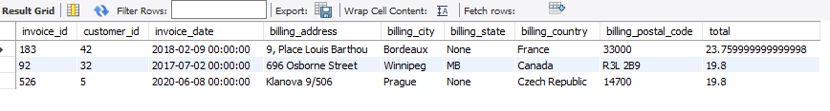
Q3: What are top 3 values of total invoice?
select * from invoice order by total desc limit 3;

Slide 20

Q4: Which city has the best customers? We would like to throw a promotional Music Festival in the city we made the most money. Write a query that returns one city that has the highest sum of invoice totals. Return both the city name & sum of all invoice totals
select billing city ,sum(total) from invoice group by billing city order by sum(total) desc limit 1;

Slide 21

Q5: Who is the best customer? The customer who has spent the most money will be declared the best customer. Write a query that returns the person who has spent the most money.
SELECT customer.customer_id , customer.first_name , customer.last_name, sum(invoice.total) from customer, invoice where customer.customer_id=invoice.customer_id group by customer.customer_id, customer.first_name, customer.last_name order by sum(invoice.total) desc limit 1;

Slide 22
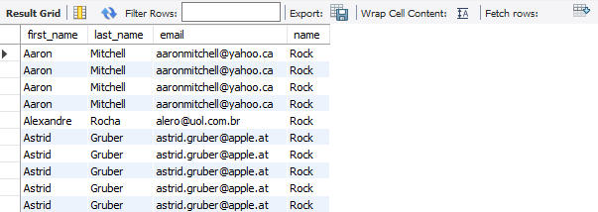
Q6: Write query to return the email, first name, last name, & Genre of all Rock Music listeners. Return your list ordered alphabetically by email starting with A.
select customer.first_name,customer.last_name,customer.email,genre.name from customer, invoice, invoice_line, track, genre where customer.customer_id=invoice.customer_id and invoice.invoice_id=invoice_line.invoice_id and invoice_line.track_id=track.track_id and track.genre_id=genre.genre_id andgenre.name="rock“ order by customer.email;

Slide 23
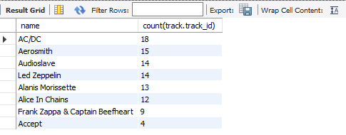
Q7: Let's invite the artists who have written the most rock music in our dataset. Write a query that returns the Artist name and total track count of the top 10 rock bands.
select artist.name, count(track.track_id) from artist join album2 on artist.artist_id=album2.artist_idjoin track on track.album_id=album2.album_idjoin genre on genre.genre_id=track.genre_id where genre.name like "rock“ group by 1order by count(track.track_id) desc limit 10;

Slide 24

Q8: Return all the track names that have a song length longer than the average song length. Return the Name and Milliseconds for each track. Order by the song length with the longest songs listed first.
select name , milliseconds from track where milliseconds>(select avg(milliseconds)from track)order by milliseconds desc limit 1;

Slide 25
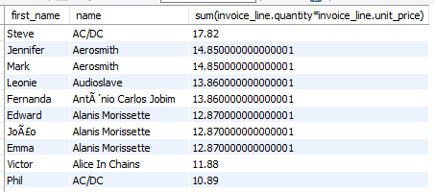
Q9: Find how much amount spent by each customer on artists? Write a query to return customer name, artist name and total spent
select customer.first_name, artist.name, sum(invoice_line.quantity*invoice_line.unit_price) from customer,invoice,invoice_line,track,album2,artistwhere customer.customer_id=invoice.customer_id and invoice.invoice_id=invoice_line.invoice_id and invoice_line.track_id=track.track_id and track.album_id=album2.album_id and album2.artist_id=artist.artist_id group by customer.first_name, artist.name order by sum(invoice_line.quantity*invoice_line.unit_price) desc;

Slide 26
REFERENCES
► GITHUB
DATABASE AND TOOLS
► MYSQL WORKBENCH

Slide 27
THANK YOU

